Slide 1
Segmentation Tool

Slide 2
Developing “Ground Truth” Data Sets
We needed to develop a “ground truth” training set for a neural network / deep learning segmentation approach
Manually annotating every cell in an image is time consuming, exhausting and exceptionally dull
We planned to modify an unsupervised cell segmentation algorithm; however, modifying against only one algorithm for ground truth leads to bias in trained AI
We compare Seyoun Park’s superpixel algorithm to inForm’s algorithm.
This allows us to accept the cells where the two algorithms agree, for disagreement decide which cells are correct, or draw an annotation when neither are

Slide 3
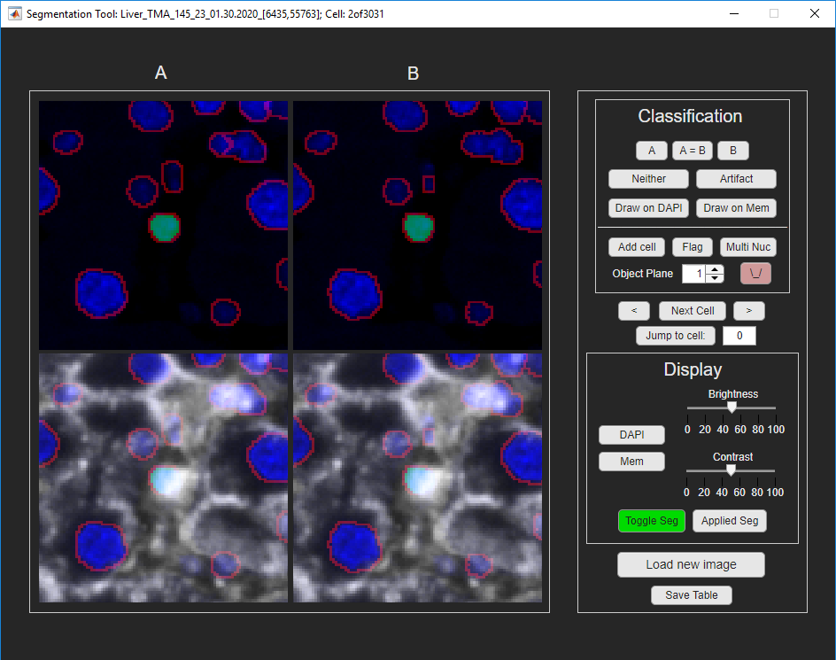
Segmentation User Interface
Compute the overlap between segmentations from Seyoun Park’s approach and inform $with the equation:\frac{2 ∗|A ∩ B|}{\left|X\right| ∗ |Y|}.$Pairs with values above .1 are identified to be compared.

Slide 4
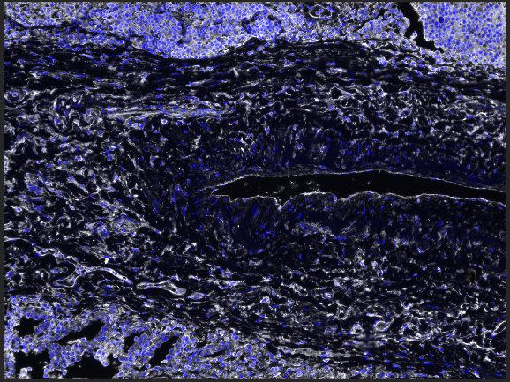
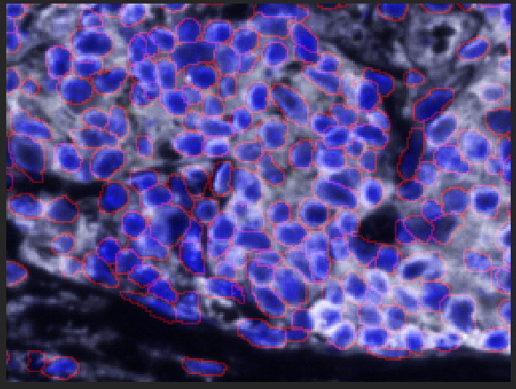
Lung_Adeno_TMA_1315_3_[5515,52497]
2,675 cells reviewed; 2,587 cells total

Slide 5
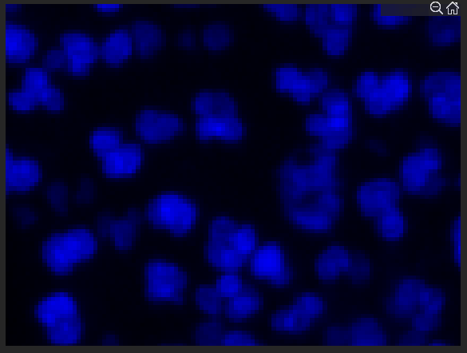
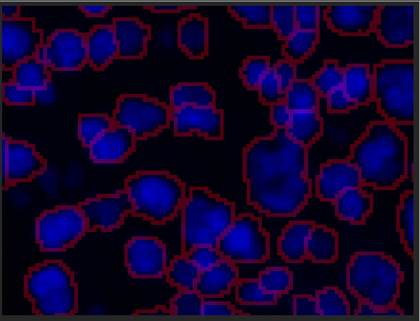
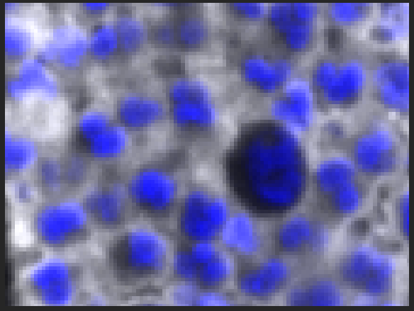
Lung_Adeno_TMA_1315_3_[5515,52497]
2,675 cells reviewed; 2,587 cells total

Slide 6
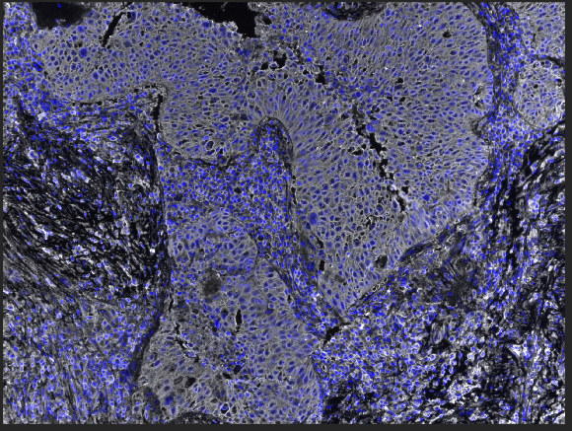
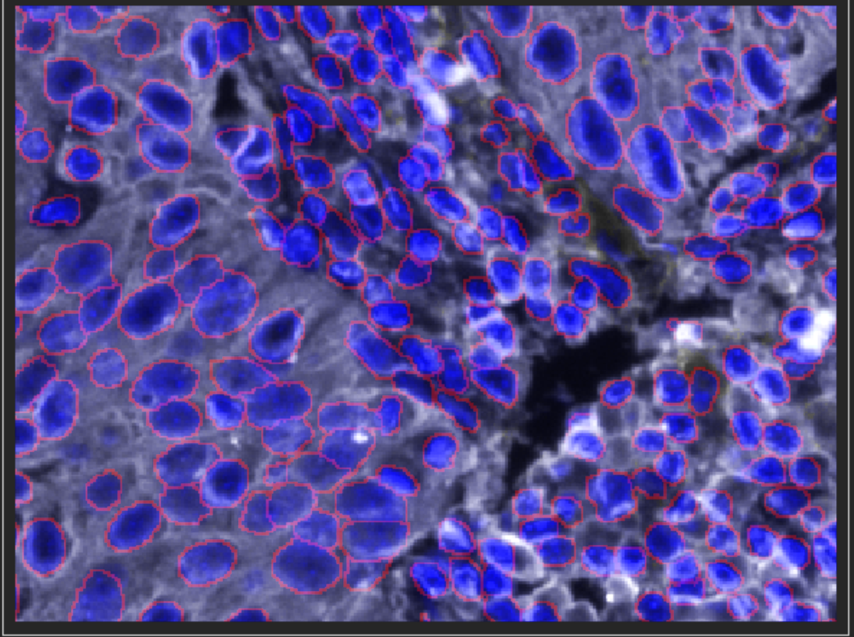
Lung_SCC_TMA_1314_6_01.30.2020
4,280 cells reviewed; 5,027 cells total

Slide 7
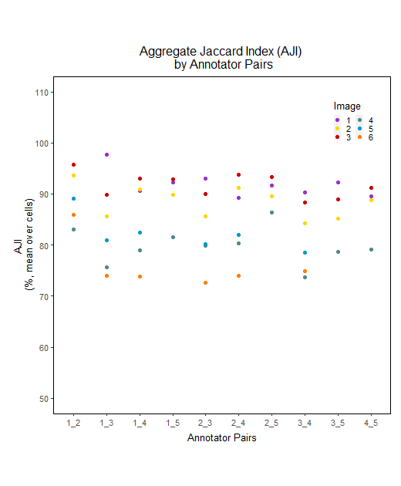
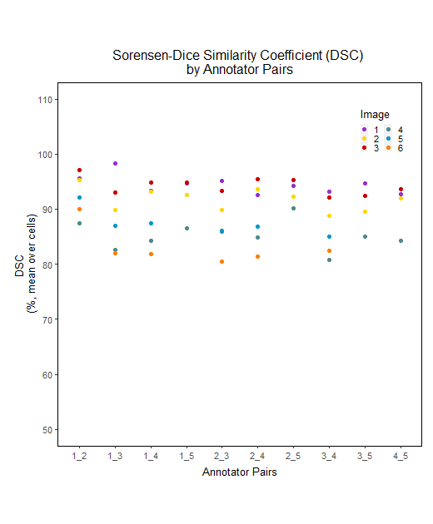
Comparison Across Users
Annotators segmented the same images to determine consistency
The mean DSC was above 80%, indicating consistency among annotators
~35,000 unique cells and 106,342 total cells have been identified
DSC (Sørensen-Dice Similarity Coefficient): explains how much overall nuclei overlap (without considering each nucleus segmentation)
AJI (Aggregate Jaccard Index): explains how well each nucleus are segmented and separated
Both measures have values 0 – 100%, where 100% means they are exactly the same

Slide 8
Next Steps
Continue building “ground truth” data set annotations
Ground truth annotation acquired on 9 Images, we plan to annotate an additional 41 images
To diversify the training set; images are from 50 different patients across 4 tumor types
Train the deep learning algorithm on “ground truth” to accurately identify the nuclei
using 40 of the images as a training set and 10 images as a test set
Integrate membrane segmentation into the deep learning approaches

Slide 9
Total ground truth cells by user
Total Cells Accepted
Reviewer | IF Non-Paired Accepted | SP Non-Paired Accepted | Drawn Cells | Added Cells | # of Pairs Accepted as IF | # of Pairs Accepted as SP | # of Pairs Accepted as Both | Total Cells
1 | 237 | 775 | 2453 | 1920 | 2897 | 1940 | 4930 | 15152
2 | 311 | 1659 | 4242 | 964 | 6704 | 6158 | 9621 | 29659
3 | 241 | 1447 | 7568 | 4082 | 4000 | 7733 | 3237 | 28308
4 | 283 | 1202 | 4040 | 4033 | 4165 | 2896 | 4880 | 21499
5 | 216 | 590 | 1691 | 1254 | 2189 | 2253 | 3531 | 11724
 |  |  |  |  |  |  |  | 106342
Since much of the cells are duplicates between users (sans users 3 & 4 who have done extra) the total of unique identified cells is ~35,000 cells
Most dense image has 10,994 cells identified after clean up

Slide 10
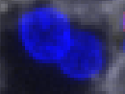
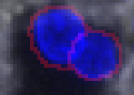
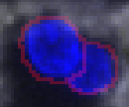


Tool Nuances
Cells with high degree of overlap between segmentation types can generally be accepted without review reducing work (all cells still reviewed in final stages)
Assigning cells to separate image-planes to handle overlapping cells
The ‘applied segmentation’ is updated in real time as the user selects segmentation
Denser, more difficult fields, can be cut into smaller more manageable image sections

Slide 11
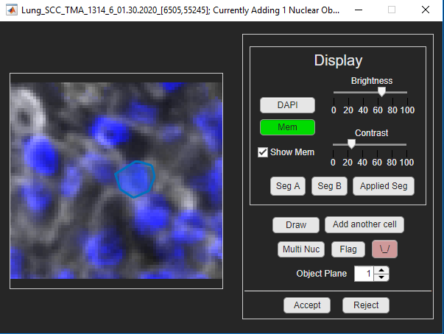
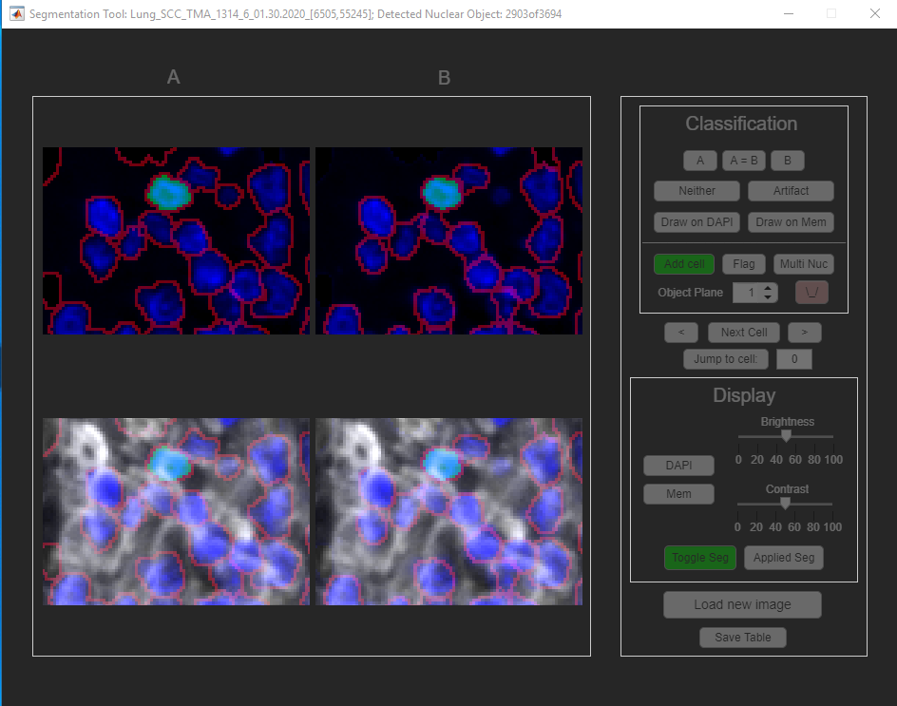
Tool Nuances Cont.
Dynamically add in new cells

Slide 12
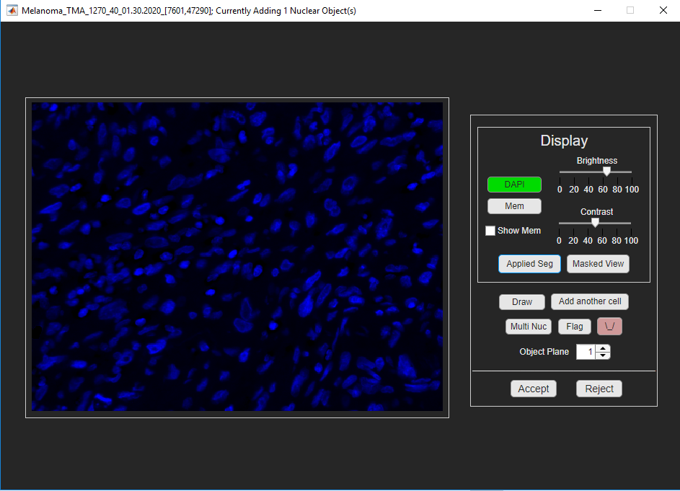
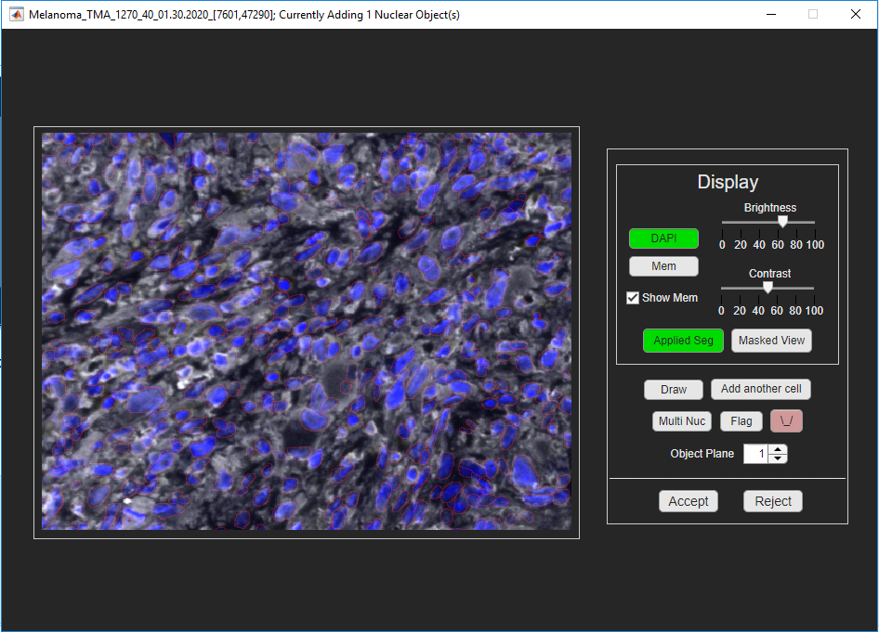
Final Image Review
Allows the final work to be reviewed before passing to ground truth training.
Super Important!!

